Slide 1

GIT AND GITHUB OPERATIONS
NAME : VARADHA . N
UID : 161101
MAIL ID : varadha.nair@ust.com
DATE : 10/12/2020

Slide 2
INTRODUCTION
Git is an open-source, version control tool created in 2005 by developers working on the Linux operating system; GitHub is a company founded in 2008 that makes tools which integrate with git. You do not need GitHub to use git, but you cannot use GitHub without using git. There are many other alternatives to GitHub, such as GitLab, Bitbucket, and “host-your-own” solutions such as gogs and gittea. All of these are referred to in git-speak as “remotes”, and all are completely optional.

Slide 3
HOW GITHUB WORKS
GitHub builds collaboration directly into the development process. Work is organized into repositories, where developers can outline requirements or direction and set expectations for team members. Then, using the GitHub flow, developers simply create a branch to work on updates, commit changes to save them, open a pull request to propose and discuss changes, and merge pull requests once everyone is on the same page.

Slide 4
THE GITHUB FLOW
The GitHub flow is a lightweight, branch-based workflow built around core Git commands used by teams around the globe—including ours.
The GitHub flow has six steps, each with distinct benefits when implemented:

Slide 5
Create a branch: Topic branches created from the canonical deployment branch (usually main) allow teams to contribute to many parallel efforts. Short-lived topic branches, in particular, keep teams focused and results in quick ships.
Add commits: Snapshots of development efforts within a branch create safe, revertible points in the project’s history.
Open a pull request: Pull requests publicize a project’s ongoing efforts and set the tone for a transparent development process.
Discuss and review code: Teams participate in code reviews by commenting, testing, and reviewing open pull requests. Code review is at the core of an open and participatory culture.
Merge: Upon clicking merge, GitHub automatically performs the equivalent of a local ‘git merge’ operation. GitHub also keeps the entire branch development history on the merged pull request.
Deploy: Teams can choose the best release cycles or incorporate continuous integration tools and operate with the assurance that code on the deployment branch has gone through a robust workflow.

Slide 6
GIT COMMANDS FOR DIFFERENT OPERATIONS

Slide 7
To check the git installed or not
git --version
Initialize git locally
git init
Configure git
git config --global user.name “username”
git config --global user.email “email@example.com”
git config --global core.editor “code --wait”
git config --global core.autocrlf true

Slide 8
Add remote origin
git add remote origin “gitrepolink.git”
Create branch
git checkout –b <branch_name>
Add file to git locally
git add .
git add <directory>
Commit file with message
git commit –m “message”

Slide 9
Checking file status in local
git status
Check difference between local and Github
git diff
git diff “fileA”
Adding file to github repository
git push origin <branch_name>

Slide 10
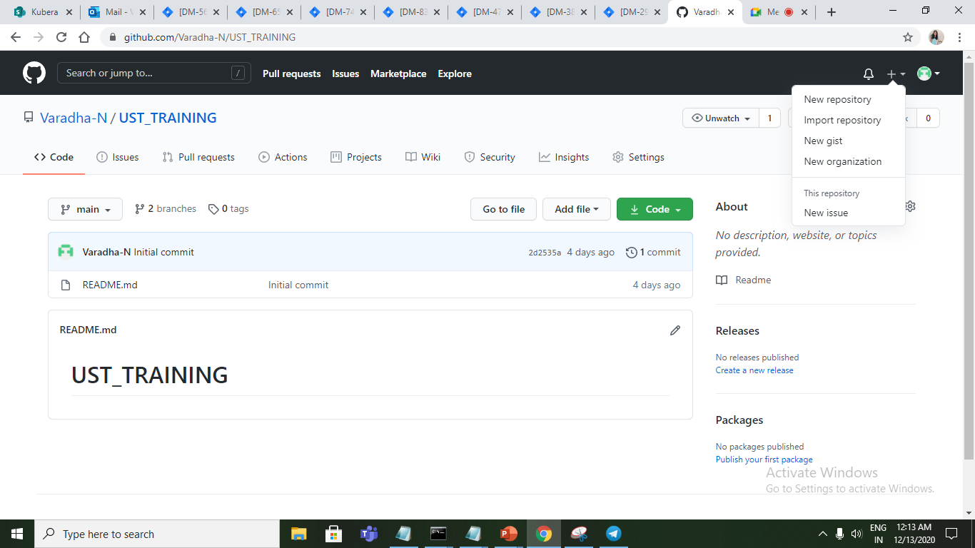
GITHUB
Creating a new repository.

Slide 11
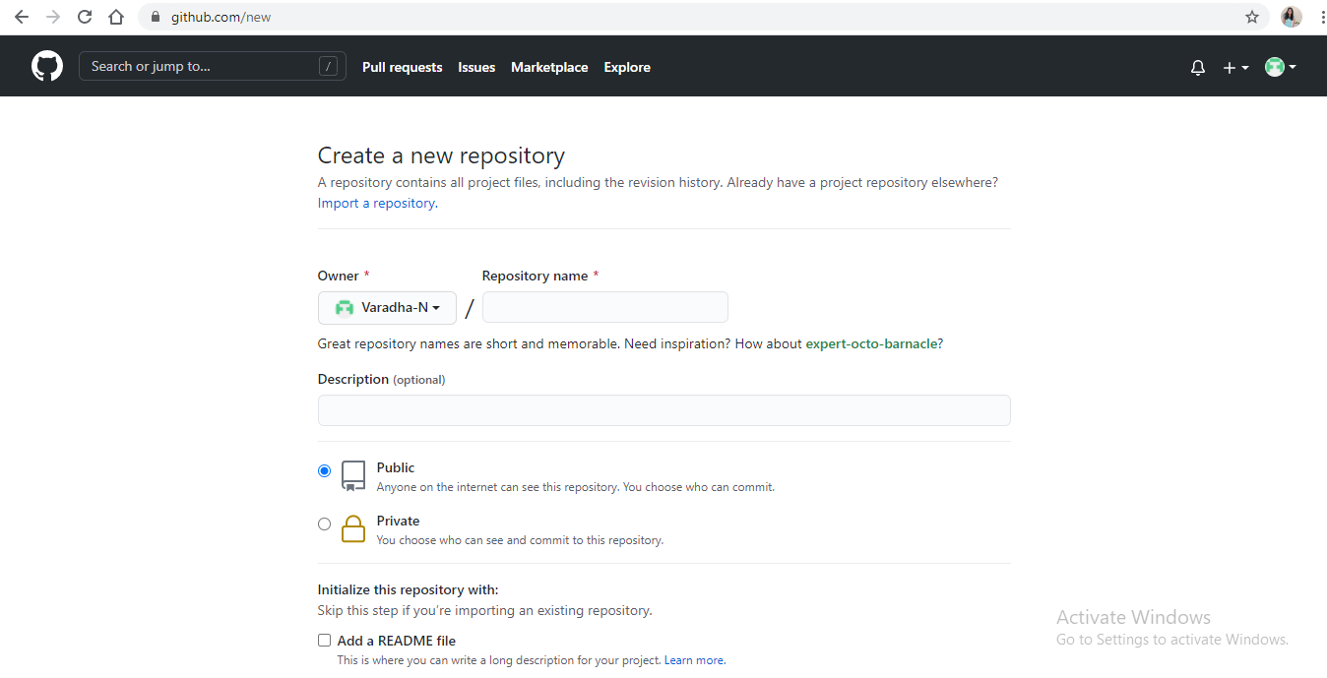

Slide 12
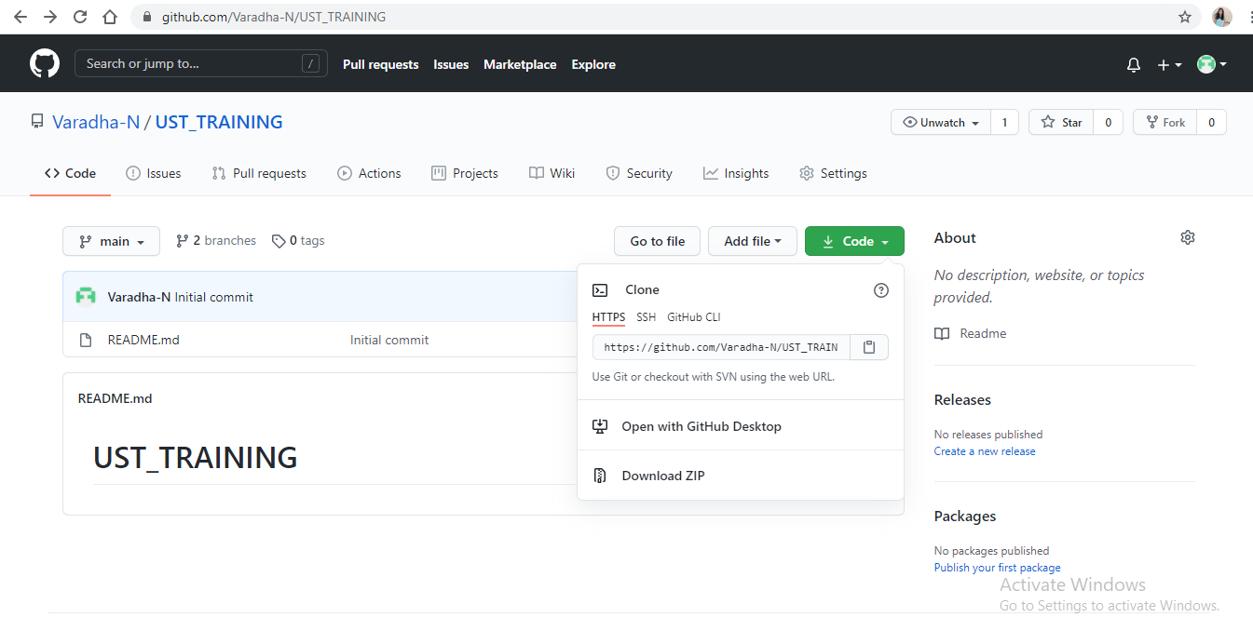
Getting Repository Link From Code button

